Slide 1





ESIDENCE
A RESIDENTIAL ASSOCIATION MANGEMENT SYSTEM

Slide 2


Meet Our Team
ANUMOL V N
ALBIN GEORGE
SNEHA M K
ANURAG K
GRESHMA P

Slide 3
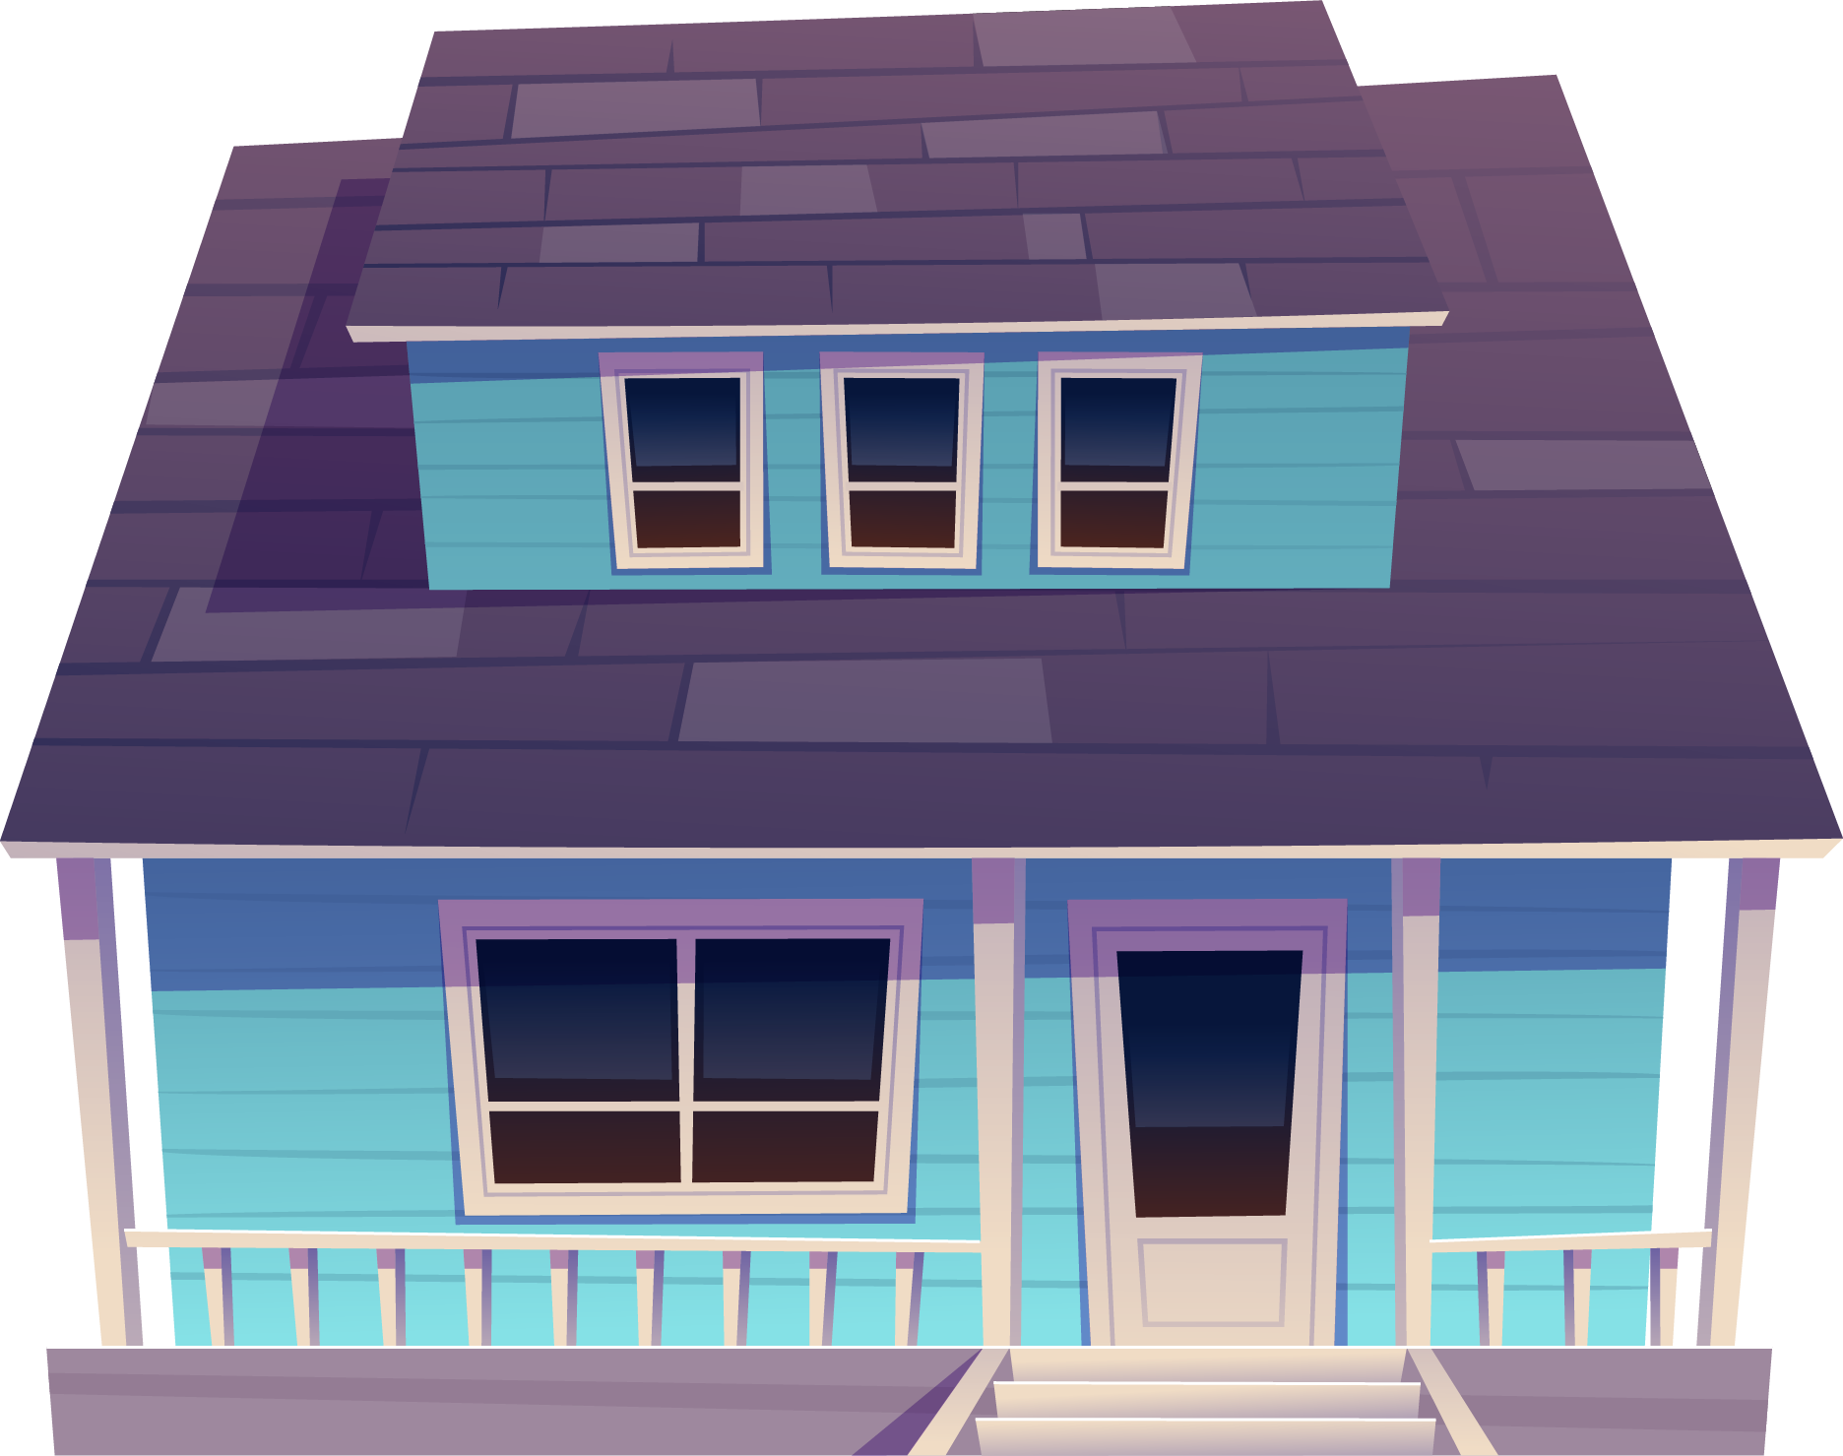


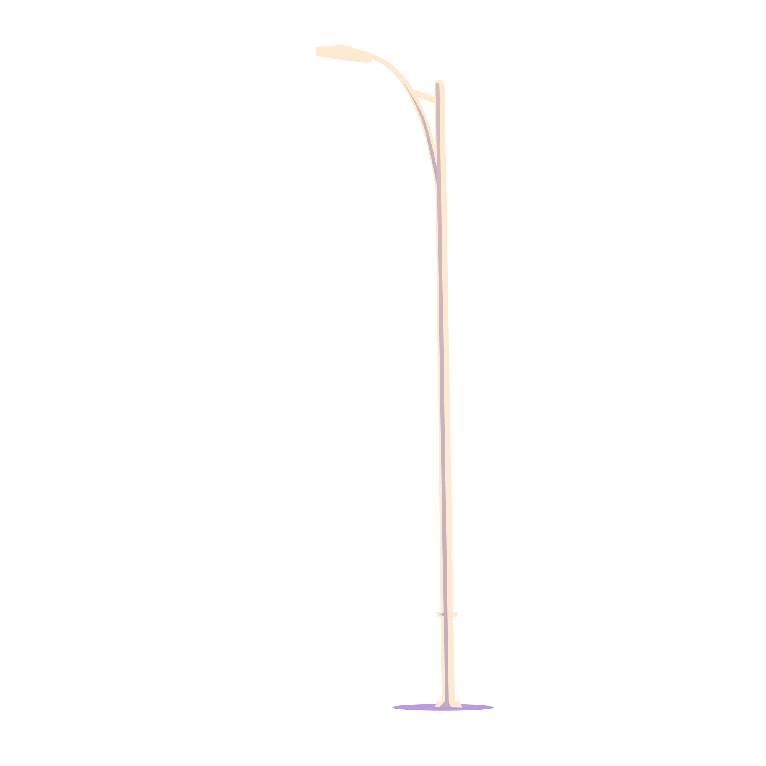

Table of contents
01
02
03
04
Existing System
Proposed System
System Requirement Specification
Actor Identification
Identification of use Case
Use Case Diagram
System Requirements
Hardware Requirements
Software Requirements
Introduction
System Analysis
Project Work Flow
List of Tables
Table Design
System Design
Introduction
Project Overview
Objective
Conclusion
Conclusion

Slide 4

INTRODUCTION
01

Slide 5
“Esidence”-Residence Management System follows “Simplicity is the ultimate sophistication” phrase and aims at making the current situation in the society simple and efficient.
Generally , in society all work is done on paper so it is very difficult to manage and keep track of all the work expenses in the society.
This system of maintaining a society, is made in such a way that most common problem faced in residential societies are solved and currently there is no automated system for the residences to know what’s happening in a society.
Our System “Esidence” reduces the conflicts that arise within the society by providing facilities such as , online hall allocation, online complain/suggestion registration, Online Event registration, Online Payment in which society member can make complain form anywhere, any time.
The main aim of the project is to provide utility to maintain day to day operations of the society .

Slide 6
Project Overview
We created a global web-based application in asp.net and angular with C# language to mange day-to-day activities of any co-operative housing society.
Admin plays a main role in the system and so he register apartments to the portal. So later own user can login with the system to give his family details in the system.
Using “Esidence” the payments can be easily noted and store all transactions history electronically so that the users can view it any time.
Esidence includes a complaint portal system which helps the users to raise their problem and notify the admin.
This System also provides a portal for event registration and response system so that family’s can request to host an event.
Esidence automates bulletin that occur within the society and makes it easy for the members of the society an easy access to the society happenings and on goings.

Slide 7
Objective
03
01
Reach maximum people at the same time.
Manage administrative tasks effectively .
04
02
Track income, expense, make payments to reduce the paperwork and make go green environment.
Solve Technical and non technical issues in the residential society.

Slide 8
02
SYSTEM ANALYSIS

Slide 9
Existing System
In the existing system all work is done physically and traditionally. Apartment details and family details are stored as a paper work. No proper facilities such for , Event Management, Complaint management, Payment management etc.
Here some basic disadvantage of the existing system
Unreachable information
Lack of authenticity and reliability
Time consuming activity
Complaints not solved quickly
Transaction issues and payment Issues

Slide 10
Proposed System
The Proposed system is Fully Computerized one. It does absolutely nothing on paper. The entire working is done with the aid of computers, this will result in faster processing and improved performance.
It contains all the necessary information about the residence/apartment included in the association.
This system contain portal for Family Details, complaint portal notification system, Event management, Accounts Management with Payment demo page, notice board ,etc.
Advantages of the proposed system
Notice Board remainders
Authentic and uninterrupted communication with society members
Time Saver and Go green Activity
Payment Demo Page, Payment History Shown

Slide 11
ACTOR IDENTIFICATION
Actors in this project are:
Admin
User

Slide 12
Identification of Use Case

Slide 13
Use case of actor Admin
Apartment View
Login/Logout
Family View
Account Sheet
Complaint View
Announcement Settings
Account Statement
Event Approval
Apartment Registration

Slide 14
Use case of actor User
Complaint Status
Login/Logout
Family Registration& Details
View Account Details
Notice Board
Payment
Event Request
Event Status
Complaint Registration

Slide 15
Use Case Diagram

Slide 16
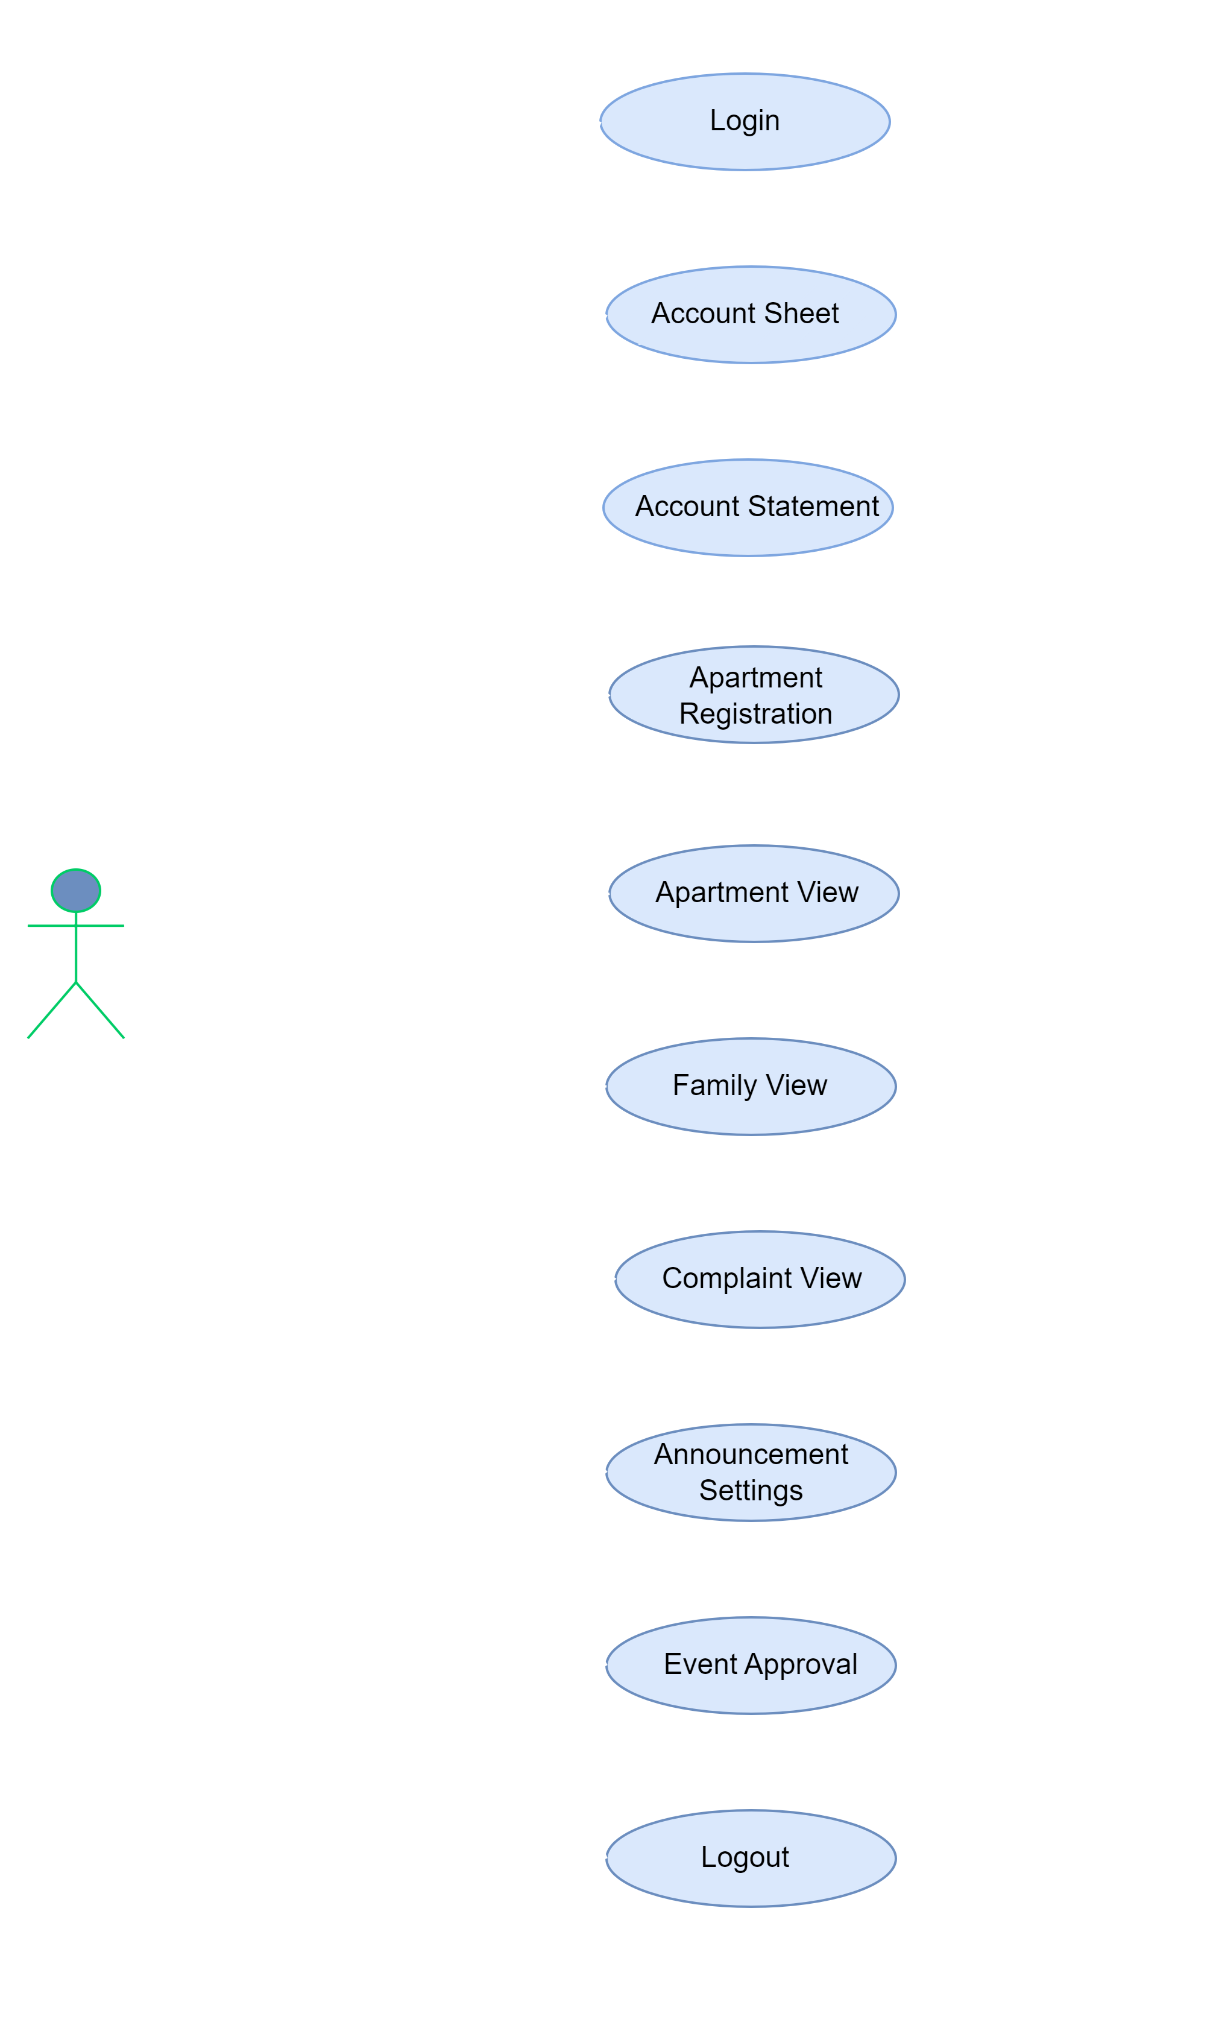
USE CASE DIAGRAM OF ADMIN

Slide 17
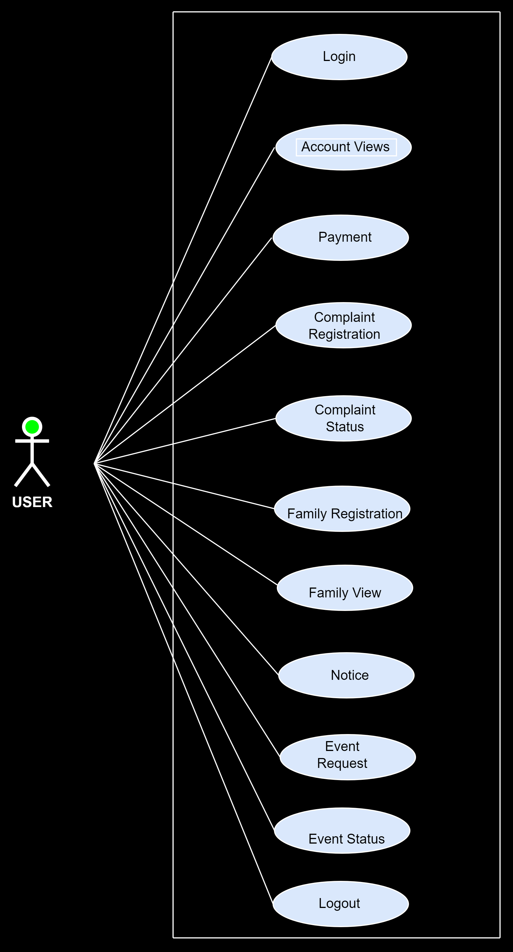
USE CASE DIAGRAM OF USER

Slide 18
System Requirements

Slide 19
Hardware Requirements
The hardware required for the application are the following:
Processor: Intel Core i5
RAM: 16GB
Storage: 512GB SSD

Slide 20


Software Requirements
The Software required for the application are the following:
IDE: Visual Studio 2022,Visual Studio Code 2022
Front End : HTML, Angular 15.0.0
Back End : C Sharp
Framework: Angular 15.0.0,.NET Core
Database: Microsoft SQL Server Management Studio V18.12.1
Platform : Windows 10

Slide 21
03
SYSTEM DESIGN

Slide 22

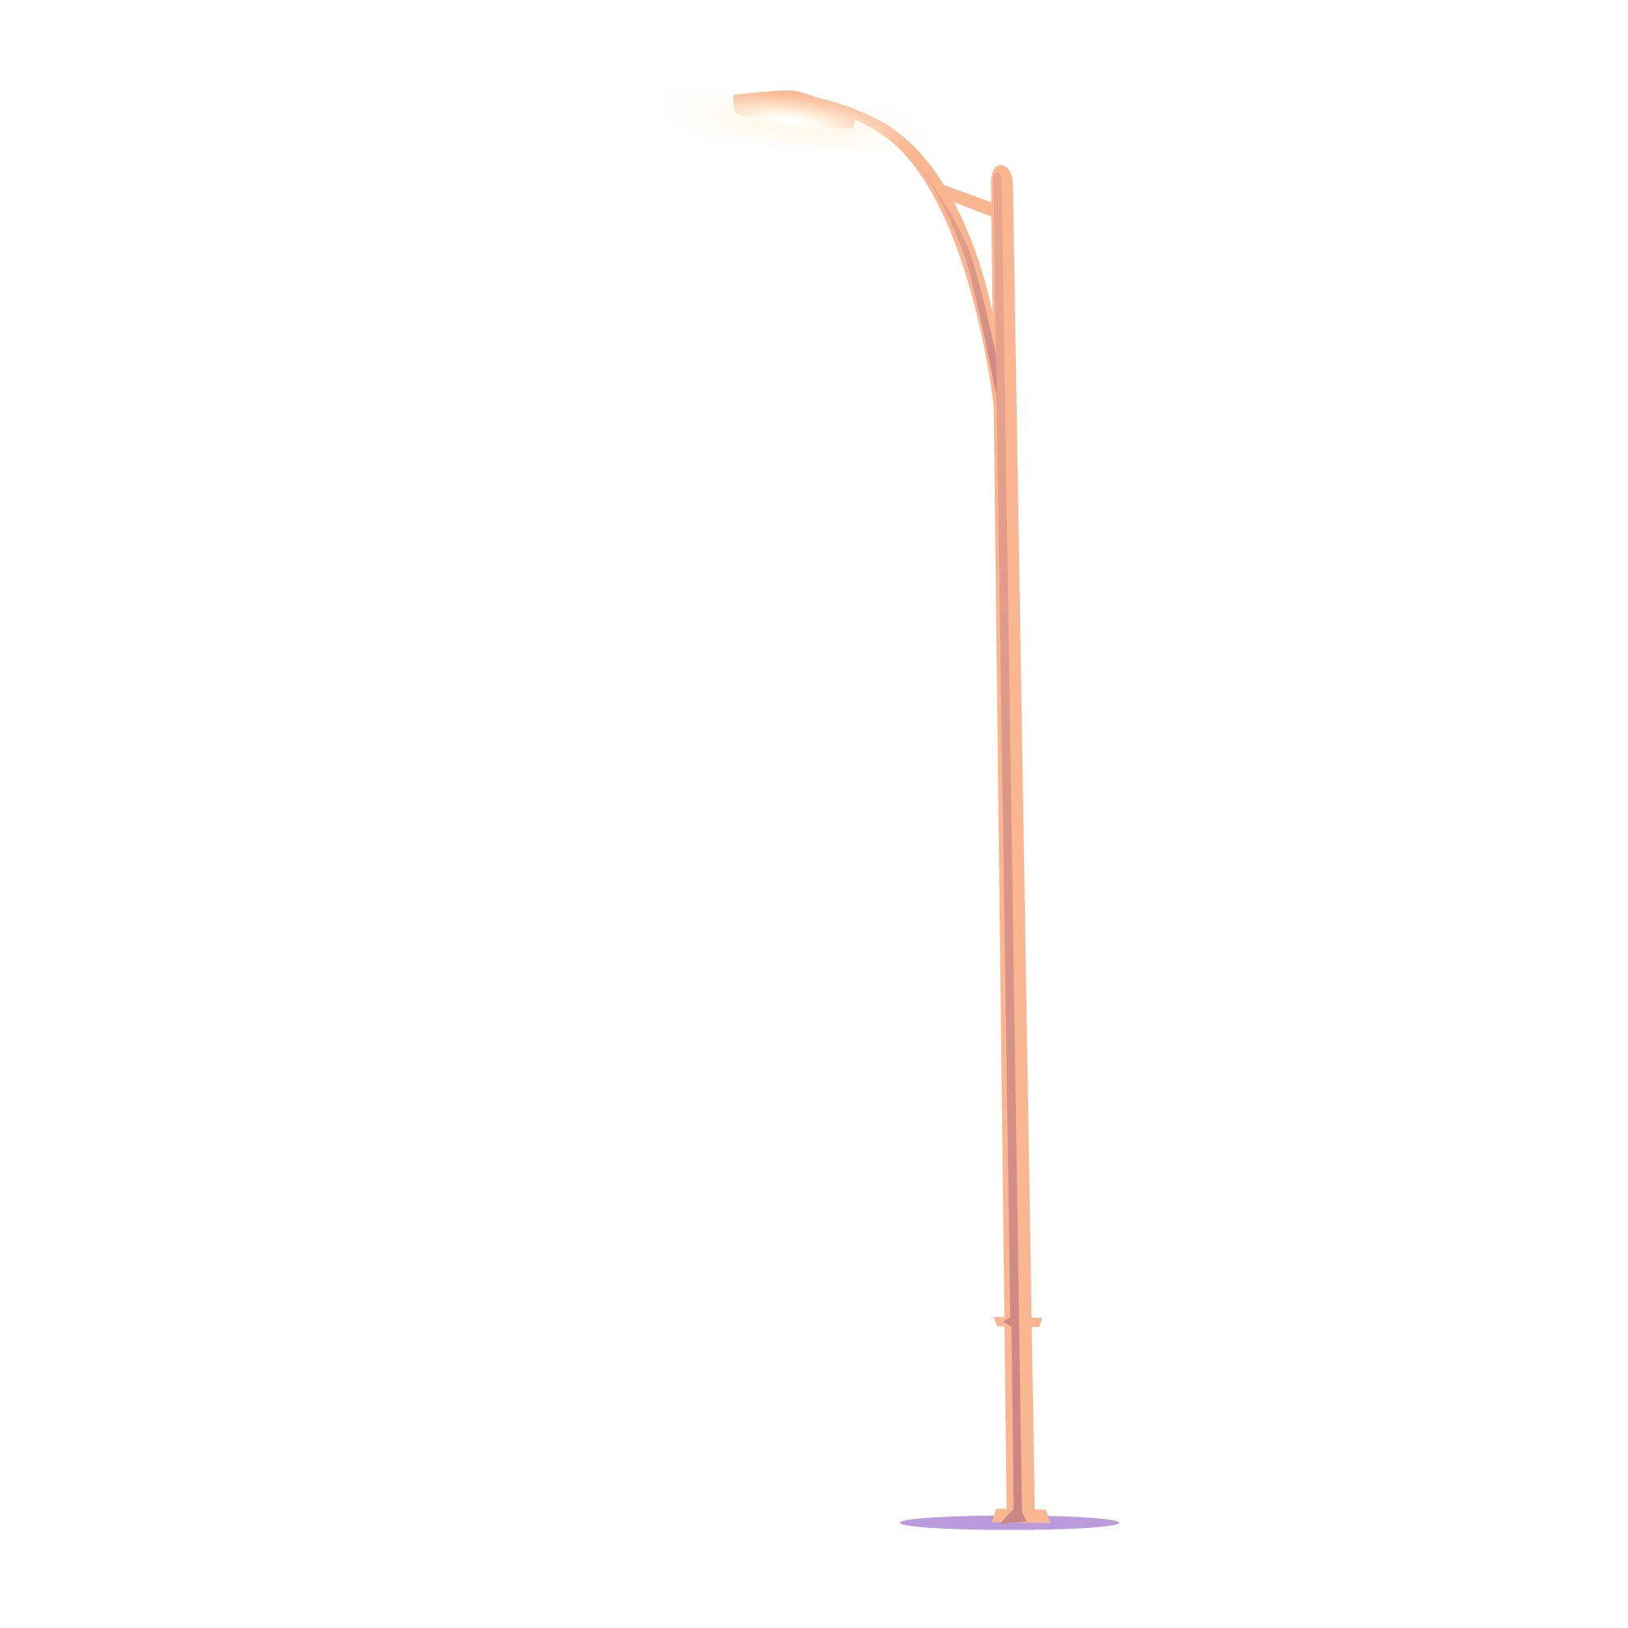
Project WorkFlow

Slide 23
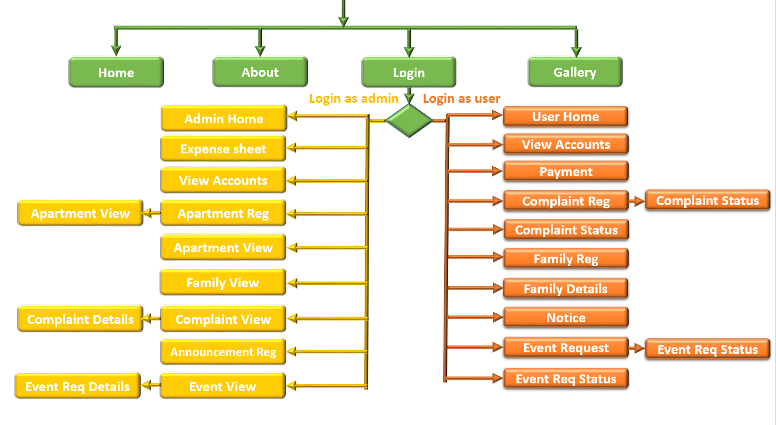

Slide 24
Table design

Slide 25
List of Tables
tblApartments
tblcomplaints
tblEventReg
tblFamily
tblNotice
tblIncome
tblDeduction

Slide 26
Table1:tblApartment
Field Name | Data Type | Constraints | Description
id | Int ,Identity | Not Null | Id of user
FirstName | Nvarchar(Max) | Not Null | User firstname
LastName | Nvarchar(Max) | Not Null | User last name
PhoneNumber | Nvarchar(Max) | Not Null | User phone number
ApartmentNumber | Nvarchar(Max) | Not Null | User apartment number
ApartmentName | Nvarchar(Max) | Not Null | User apartment name
UserName | Nvarchar(Max) | Not Null | User name
Password | Nvarchar(Max) | Not Null | User password

Slide 27
Table2:tblcomplaint
Field Name | Data Type | Constraints | Description
id | Int, Identity(1,1) | Not Null | Id of user
ApartmentNumber | Nvarchar(Max) | Not Null | User apartment number
UserName | Nvarchar(Max) | Not Null | User name
ComplaintSubject | Nvarchar(Max) | Not Null | Subject of Complaint
Complaints | Nvarchar(Max) | Not Null | Complaint Details
status | Nvarchar(Max) | Not Null | Status of complaint

Slide 28
Table3: tblEventReg
Field Name | Data Type | Constraints | Description
id | Int,Identity(1,1) | Not Null | Id of user
ApartmentNumber | Nvarchar(Max) | Not Null | User apartment number
UserName | Nvarchar(Max) | Not Null | User name
Event | Nvarchar(Max) | Not Null | Event Registration
EventDetails | Nvarchar(Max) | Not Null | Upcoming Event details
date | Nvarchar(Max) | Not Null | Date of Event
Status | Nvarchar(Max) | Not Null | Status of Event confirmed or not

Slide 29
Table4: tblFamily
Field Name | Data Type | Constraints | Description
id | Int ,Identity(1,1) | Not Null | Id of user
FirstName | Nvarchar(Max) | Not Null | User firstname
LastName | Nvarchar(Max) | Not Null | User last name
inlineRadioOptions | Nvarchar(Max) | Not Null | Gender of user
dob | Nvarchar(Max) | Not Null | Date of birth of user
Email | Nvarchar(Max) | Not Null | User email
PhoneNumber | Nvarchar(Max) | Not Null | Phone number of user
Occupation | Nvarchar(Max) | Not Null | Occupation of user
ApartmentNumber | Nvarchar(Max) | Not Null | User apartment number
ApartmentName | Nvarchar(Max) | Not Null | User apartment name

Slide 30
Table5: tblNotice
Field Name | Data Type | Constraints | Description
id | Int,Identity(1,1) | Not Null | Id of user
date | Nvarchar(Max) | Null | Date of Event
Title | Nvarchar(Max) | Null | Event Title
Subject | Nvarchar(Max) | Null | Subject of Event

Slide 31
Table6: tblIncome
Field Name | Data Type | Constraints | Description
Field Name | Data Type | Constraints | Description
id | Int,Identity(1,1) | Not Null | Id of user
ApartmentNumber | Nvarchar(Max) | Not Null | User apartment number
UserName | Nvarchar(Max) | Not Null | User name
Event | Nvarchar(Max) | Not Null | Event Registration
paymentamt | Nvarchar(Max) | Not Null | Amount to pay
date | Nvarchar(Max) | Not Null | Date of Event

Slide 32
Table7: tblDeduction
Field Name | Data Type | Constraints | Description
id | Int | Not Null | Id of user
Paymentamt | Nvarchar(Max) | Not Null | Date of Event
event | Nvarchar(Max) | Not Null | Event details
date | Nvarchar(Max) | Not Null | Date of Event

Slide 33
04
CONCLUSION

Slide 34


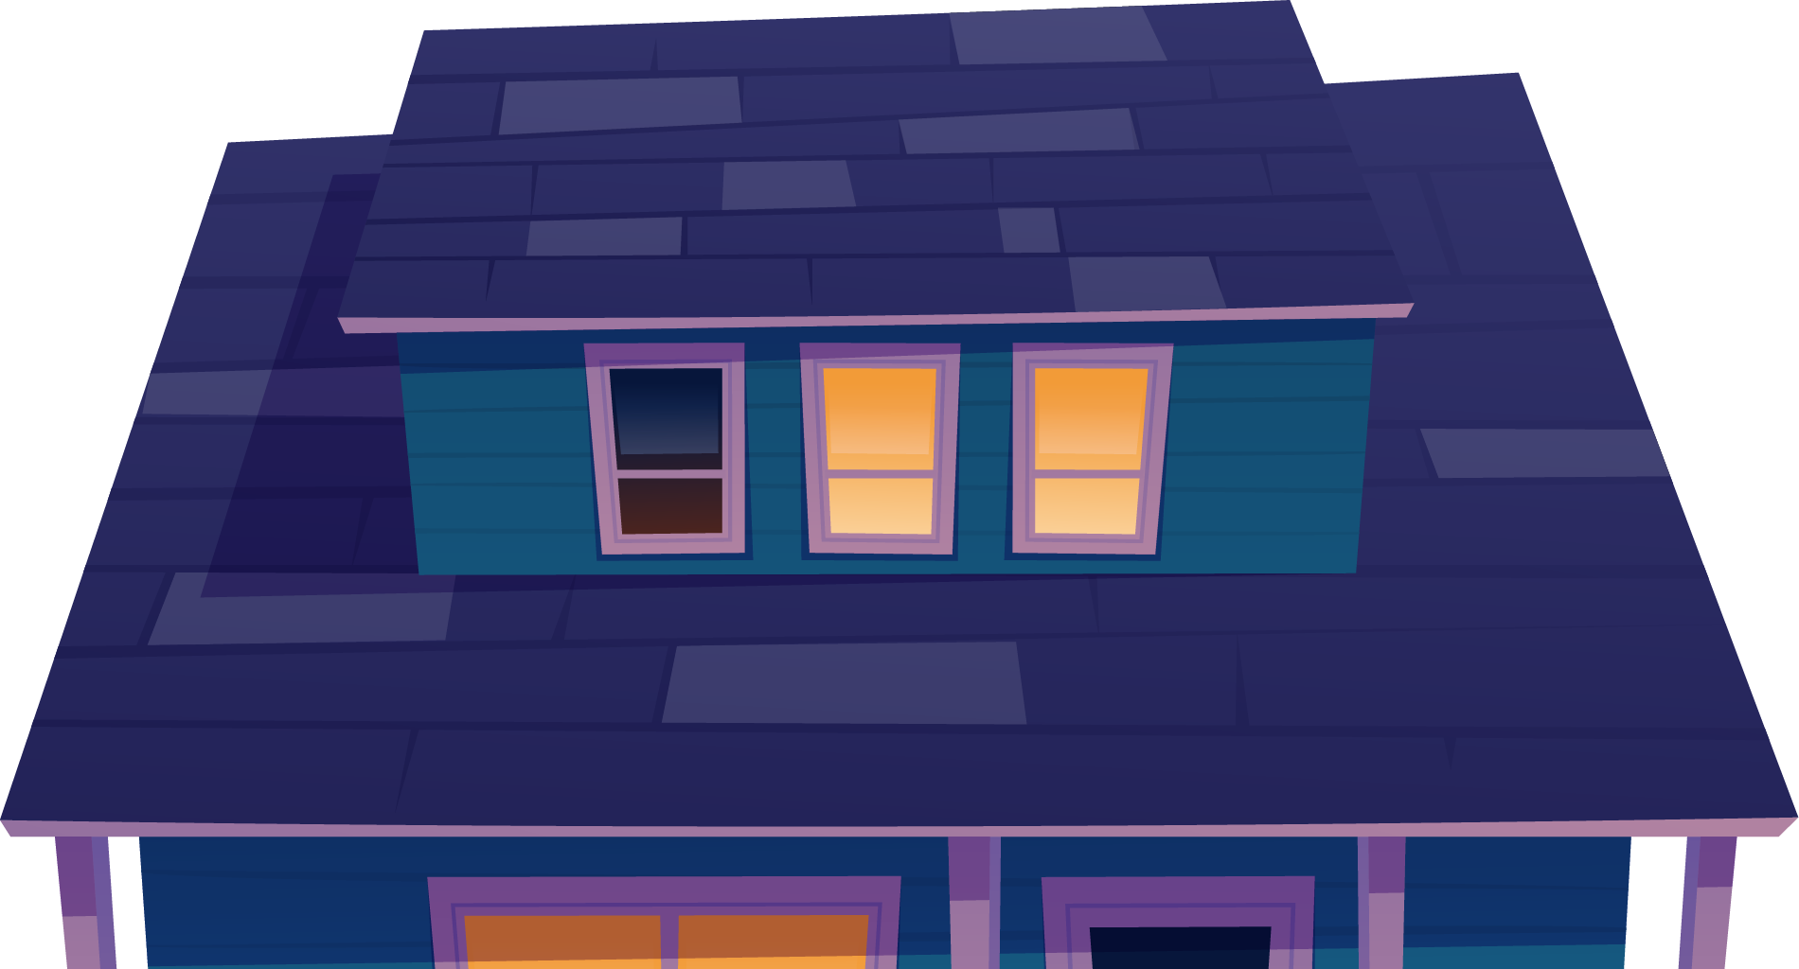



The entire solution will provide a hassle free, user friendly affordable communication platform to develop healthy relations between housing society members and a smarter way of interconnectivity.
Application manages housing society through “Notice push technology” that will assist the society members to play their roles effectively.
Chairman or secretary will play the role of administrator allowing registration of residents so that they can use these registration details to login and to access the services.
This project may use concepts of data mining and artificial intelligence And economical management for future work.

Slide 35


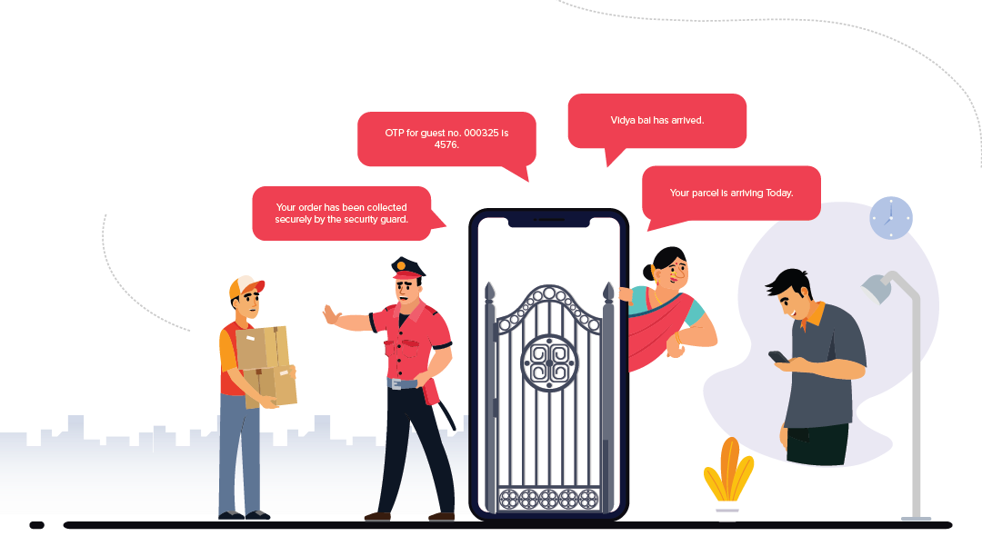
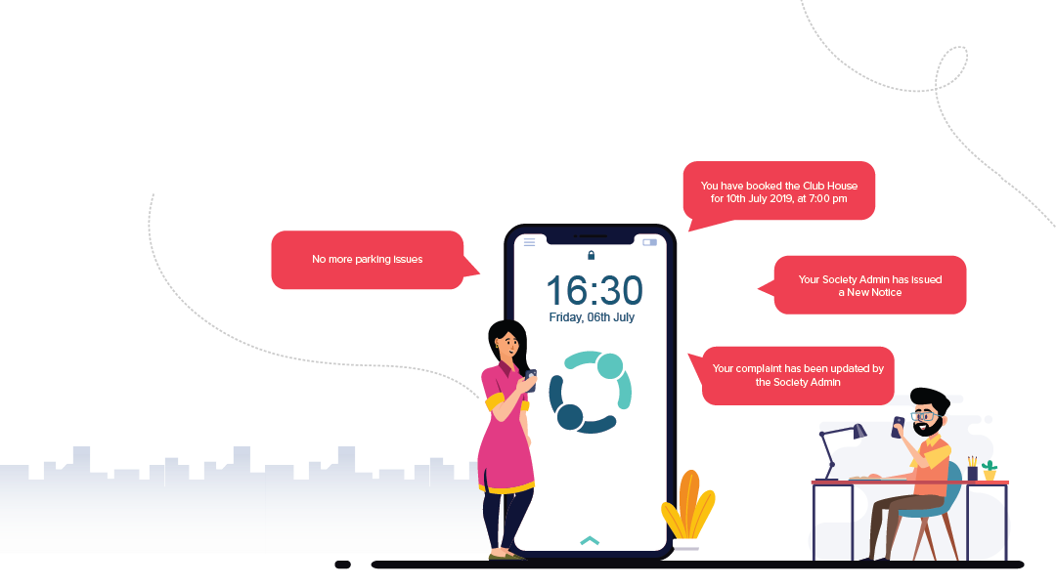
Thank
you

Slide 36
Do You Have Any Questions?

